Slide 1


A Web-Based Gamified Fitness System Which Enhances Motivation and General Well-Being

Slide 2
Aim of the Project
This project aims to develop a system that adopts gamification features to address the lack of motivation in individuals who often encounter when trying to engage in physical activities.

Slide 3
How did I get an idea for this project?
I got this idea due to my own personal experience.
By researching, I came across Webley’s article that many people have New Year’s Resolutions of getting fit.
McGonigal said that many people sign up in January and the numbers diminished by mid-February.
A possible solution is gamification.

Slide 4
Product Research
Fitbit (85)
Zombies, Run! (81)
Jefit (81)

Slide 5
Rich Picture

Slide 6
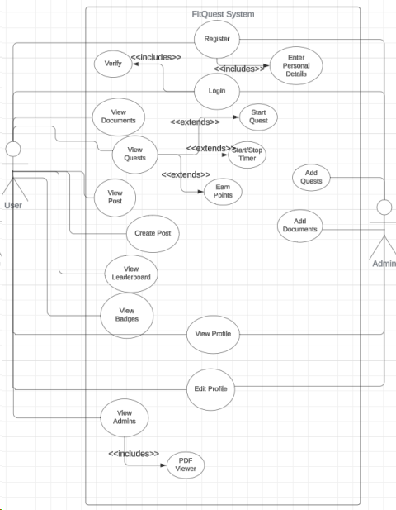
Use-Case Diagram

Slide 7
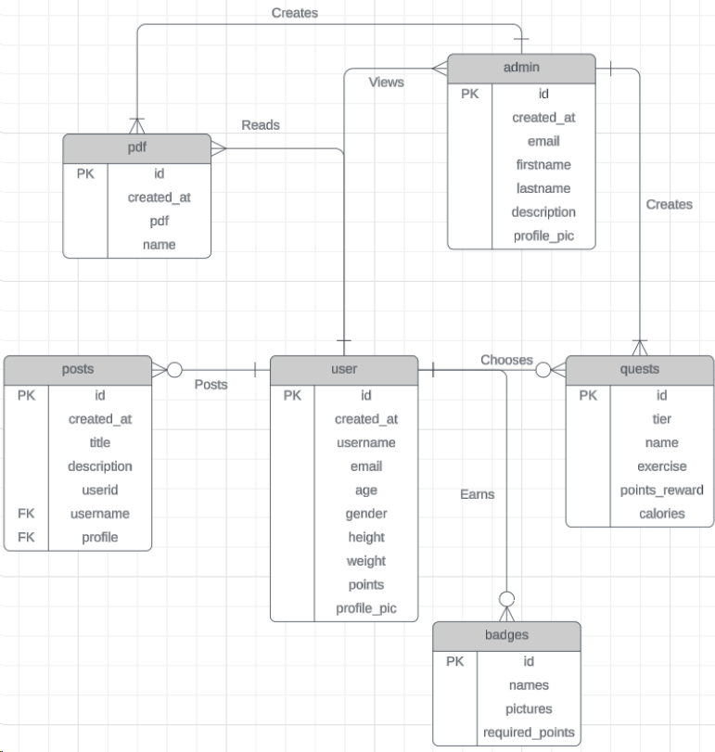
ERD

